Slide 1

DATA ANALYTICS INTERNSHIP REPORT
Sales Dashboards, Customer Segmentation,
Predictive Analytics & Reporting Automation
Amit Kushwaha | B.Tech CSE, IILM University, Greater Noida | Batch 2026-27
Organization: Thiranex • Role: Intern – Data Analytics • 26 Aug – 25 Sept 2026
Submitted to the School of Computer Science and Engineering, IILM University
in partial fulfilment of the requirement for the degree of B.Tech CSE

Slide 2


SECTION 1–2
Declaration & Acknowledgement
Candidate's Declaration
Acknowledgement
I, Amit Kushwaha, declare that this internship report on Data Analytics has been completed by me to fulfil the requirement for the degree of B.Tech in CSE. All references have been duly quoted, and the report is entirely my own original work.
Sincere gratitude to Thiranex for the opportunity to undertake this Data Analytics internship, and for the guidance, resources and feedback provided throughout. Thanks also to the faculty of the School of CSE, IILM University, for their academic support, and to my parents for their constant encouragement.
Signature: ______________________
Student Name: AMIT KUSHWAHA
Roll No.: ______________________
Thiranex Data Analytics Internship • Amit Kushwaha
2

Slide 3
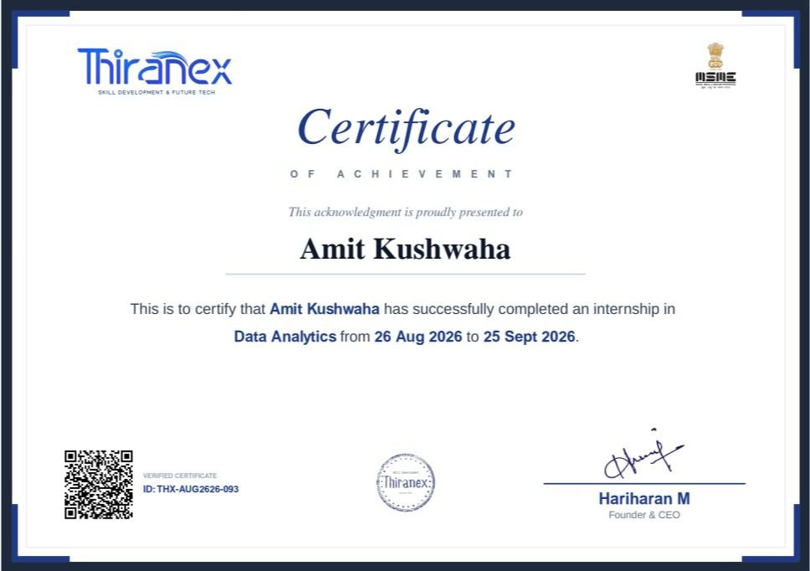
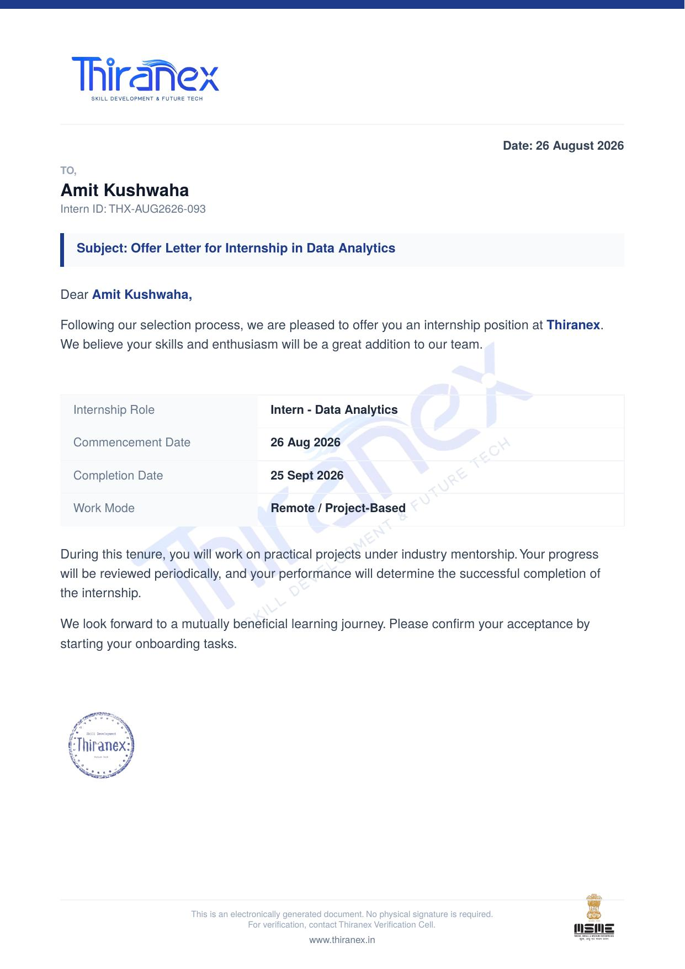
SECTION 3
Certificate & Offer Letter
Certificate ID: THX-AUG2626-093 • 26 Aug – 25 Sept 2026
Offer Letter — Intern, Data Analytics
Remote / Project-Based
Thiranex Data Analytics Internship • Amit Kushwaha
3

Slide 4




SECTION 4.1
Introduction
The Data Analytics internship at Thiranex provided practical, end-to-end exposure to a business analytics workflow — moving from dashboarding and segmentation through to predictive analytics and automated reporting.
1. Sales & Revenue Dashboard
2. Customer Segmentation
3. Predictive Analytics
4. Cleaning & Automation
Visualise KPIs — total sales, revenue trends, top products.
Cluster customers by behaviour and demographics.
Forecast trends with regression / time-series models.
Automate cleaning, handle gaps, generate reports.
Together these four tasks build an end-to-end understanding of preparing, visualising, modelling and communicating business data.
Thiranex Data Analytics Internship • Amit Kushwaha
4

Slide 5

ORGANIZATION PROFILE
Thiranex — Skill Development & Future Tech
Thiranex is a skill development and future technology organization. Its internship portal offers a structured Data Analytics learning path with practical assignments, task tutorials, and completion tracking — allowing interns to progress through real business-analytics scenarios with mentor visibility at every stage.
4
26 Aug
25 Sept
100%
Structured
Tasks Completed
Internship
Commencement
Internship
Completion
Tasks Submitted
On Track
Thiranex Data Analytics Internship • Amit Kushwaha
5

Slide 6

SECTION 4.3
Problem Statement
Business data is often spread across multiple sources, inconsistent, or difficult to interpret in raw form — making it hard for organizations to draw timely insights, while still needing methods that summarise performance, segment customers, forecast trends, and keep reporting reliable.
The internship addressed this through four connected problems:
1
Preparing and visualising raw sales data on an interactive dashboard
2
Segmenting customers using behavioural and demographic attributes
3
Forecasting future trends from historical, time-based data
4
Automating the data cleaning and reporting workflow to cut manual effort
Thiranex Data Analytics Internship • Amit Kushwaha
6

Slide 7
SECTION 4.4
Project Objectives
1
Understand the workflow of a business analytics dashboard
6
Build predictive models (regression / time-series)
2
Import and consolidate sales & revenue data
7
Clean and preprocess historical datasets
3
Visualise KPIs with charts, filters and slicers
8
Evaluate model accuracy and visualise predictions
4
Segment customers using clustering techniques
9
Automate data cleaning and reporting workflows
5
Analyse purchase patterns and preferences
10
Develop analytical thinking and reporting skills
Thiranex Data Analytics Internship • Amit Kushwaha
7

Slide 8

SECTION 4.5
Scope of the Project
End-to-End Coverage
In Scope
Data import & cleaning
The internship's scope spans the complete data-analytics workflow — from raw data preparation to dashboarding, segmentation, predictive analysis and automated reporting. It includes data import and cleaning, KPI visualisation, clustering-based segmentation, regression / time-series modelling, model evaluation, and automated report generation.
The work is educational and practical, and the predictive-analytics component can be adapted to different historical datasets across business contexts, forming a foundation for advanced forecasting, dashboard automation, and BI-platform integration.
KPI dashboarding
Customer segmentation
Predictive modelling
Model evaluation
Automated reporting
Thiranex Data Analytics Internship • Amit Kushwaha
8

Slide 9

SECTION 4.6
Technologies & Tools Used
Python
Pandas
Excel / Power BI
Primary language for analysis & modelling
Loading, cleaning & transforming data
Dashboards & interactive reporting
Matplotlib / Seaborn
Scikit-learn
Jupyter / Colab
Visualisations & analytical plots
Clustering & regression / time-series
Interactive coding environment
Thiranex Data Analytics Internship • Amit Kushwaha
9

Slide 10

SYSTEM ARCHITECTURE
The Analytics Pipeline
Raw Data
Import
→
Clean &
Preprocess
→
Dashboard
& KPIs
→
Segment
Customers
→
Predictive
Model
→
Evaluate &
Report
Raw sales, customer and historical data flows through cleaning, dashboarding and segmentation, into predictive modelling — closing with automated, report-ready insights.
Thiranex Data Analytics Internship • Amit Kushwaha
10

Slide 11
SECTION 4.8 — TASK 1 & 2
Methodology
Task 1: Sales & Revenue Dashboard
Task 2: Customer Segmentation
Sales and revenue data was imported from Excel, CSV or a database. KPIs such as total sales, revenue trends, and top-performing products were visualised using charts, filters and slicers for interactive analysis.
Customers were segmented by behaviour and demographics using clustering (scikit-learn / Power BI). Purchase patterns and preferences were analysed, and segment characteristics were visualised.
OUTCOME
OUTCOME
Data visualisation, KPI tracking and business insight generation.
Customer analytics, segmentation and targeted insights.
Thiranex Data Analytics Internship • Amit Kushwaha
11

Slide 12
SECTION 4.8 — TASK 3 & 4
Methodology
Task 3: Predictive Analytics
Task 4: Cleaning & Reporting Automation
A predictive model was built using regression or time-series techniques to forecast future trends. Historical datasets were cleaned and preprocessed before training, and predictions were evaluated and visualised.
Data cleaning and reporting workflows were automated using Python, Excel or Power BI. Missing values, duplicates and inconsistent data were handled, and automated reports and visual summaries were generated.
OUTCOME
OUTCOME
Predictive modelling, trend analysis and data-driven forecasting.
Data preprocessing, automation and reporting efficiency.
Thiranex Data Analytics Internship • Amit Kushwaha
12

Slide 13
SECTION 4.9
Expected Outcomes
Improved understanding of dashboard design & KPI visualisation
Ability to import, consolidate and visualise sales data
Practical experience in customer segmentation (clustering)
Improved understanding of purchase-pattern analytics
Ability to build and evaluate predictive models
Practical experience preprocessing historical datasets
Understanding of automated cleaning & reporting workflows
Stronger analytical thinking & business insight generation
Thiranex Data Analytics Internship • Amit Kushwaha
13

Slide 14
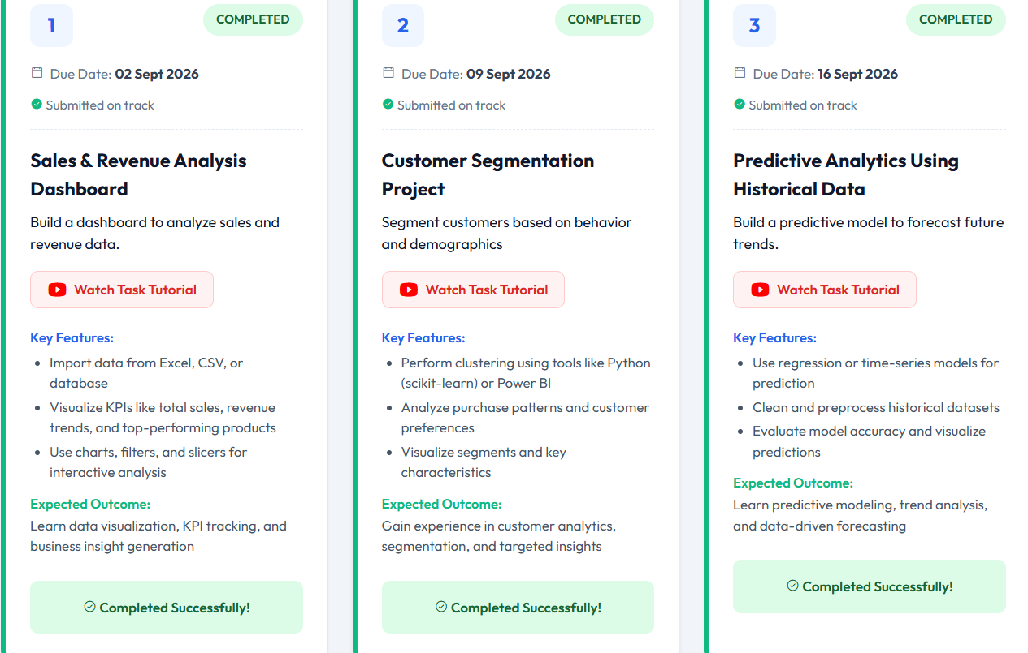
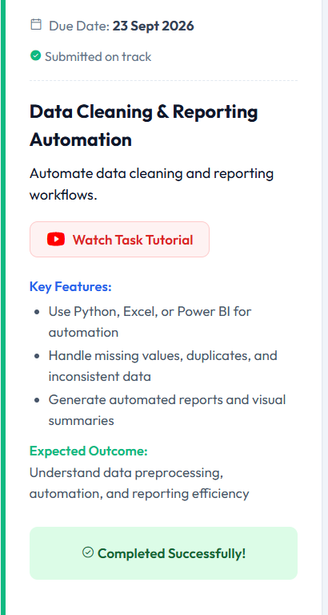
SECTION 4.10
Task Completion Evidence
Fig 4.1 — Tasks 1–3 completed & submitted on track
Fig 4.2 — Task 4 completed & submitted on track
Thiranex Data Analytics Internship • Amit Kushwaha
14

Slide 15

BIBLIOGRAPHY / REFERENCES
1
Thiranex Internship Portal — Data Analytics Task Descriptions & Completion Records
2
Pandas Documentation — Python Data Analysis Library
3
Matplotlib Documentation — Python Plotting Library
4
Seaborn Documentation — Statistical Data Visualization Library
5
Scikit-learn Documentation — Machine Learning in Python
Thank You
Amit Kushwaha • B.Tech CSE, IILM University • Thiranex Data Analytics Internship

